Slide 1
Croatian Musicians
Elementary School Vladimir Nazor Ploče – Croatia
Ingrid & Rebeka Vlaho Oršulić (8.c)
October, 2014

Slide 2
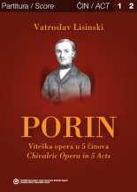
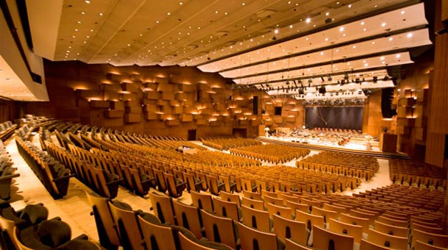
Vatroslav Lisinski
Born in Zagreb in 1819 Ignaz Fuchs from a German Jewish family later changed his name into Vatroslav Lisinski
He was one of the founders of Illyrism, the movement advocating the importance of Croatian cultural heritage, as a reaction to Magyarisation during the Austro-Hungarian rule
He worked as a clerk but joined the first Croatian Choir Society as a conductor.
He became the founder of Croatian opera, writing „Love and Malice”, the first Croatian opera, in 1846.
He created numerous works for orchestra, choir and solo. In 1851 he wrote his second opera „Porin”, but didn’t live to see its first performance.
Lisinski died in Zagreb on 31 May 1854.
Concert Hall Lisinski, Zagreb

Slide 3
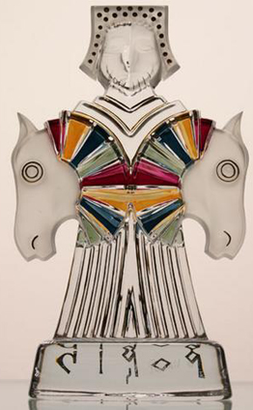
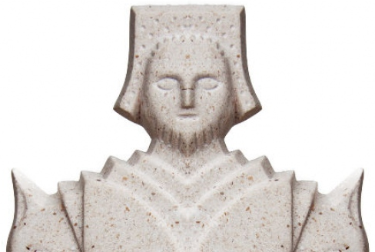
Porin
To honor Lisinski, the Croatian Music Award was named after his second opera.
Porin was founded by Croatian Phonographic Association, the Croatian Musicians Union, Croatian Radio-Television and Croatian Composers' Society.
The Awards are given every year, in the following categories:
Lifetime Achievement Award
General categories
Song of the Year
Album of the Year
Best video
Genre-specific awards
Best Club Album
Best Pop Album
Best Rock Album
Symbol of the award is a statuette about
30 cm tall created by Ivica Propadalo.
The statuette is made of glass, marble
from the island of Brač, or of black chrystal.

Slide 4
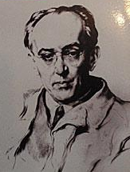
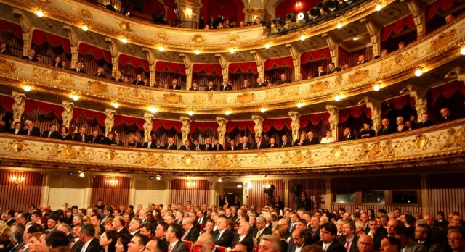
Jakov Gotovac
Jakov Gotovac (October 11, 1895 – October 16, 1982)
was a Croatian composer and conductor of classical music.
His comic opera, Ero s onoga svijeta (Ero the Joker), Croatia's best-known opera, was first performed in Zagreb in 1935.
Ero s onoga svijeta (usually translated as Ero the Joker, literally Ero from the other world) is a comic opera in three acts by Jakov Gotovac, with a libretto by Milan Begović based on a folk tale. The genesis of the opera was at Vrlička Česma in the town of Vrlika, a hometown of Milan Begović.
According to Croatian musicologist Josip Andreis, Ero s onoga svijeta is "not only the most successful Croatian comic opera to this day, but also the only Croatian opera with constant presence in the theaters abroad"
Zagreb Opera House

Slide 5
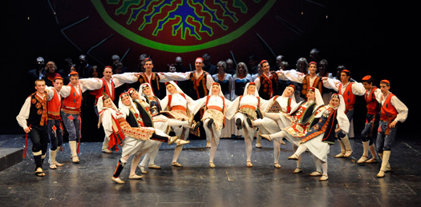
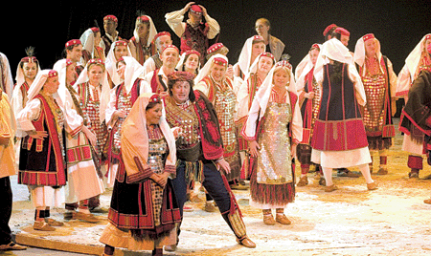
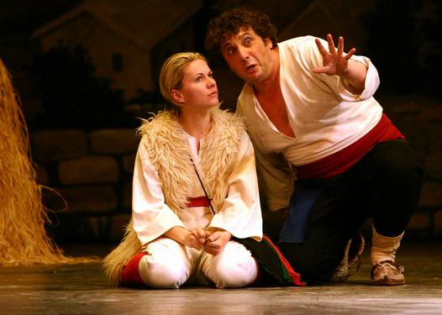

Slide 6
Tomislav Uhlik
Tomislav Uhlik was a student of physics when, encouraged by the composer and conductor Emil Cossetto, he discovered an interest in music.
He enrolled the Zagreb Academy of Music to study theory of music in 1978. He began composing as a student.
Between 1986 and 1989 he studied conducting at the Zagreb Academy of Music, graduating in Igor Gjadrov’s class.
In the meantime he worked first as rehearsal pianist and then conductor in the Zagreb "Komedija" Theatre, where he conducted six operetta premieres since 1992.

Slide 7
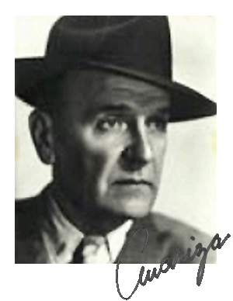
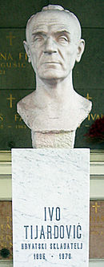
Ivo Tijardović
IVO TIJARDOVIĆ 1895 –1976, was a Croatian composer, writer, and painter from Split, a member of the Unitary National Liberation Front. He was the 47th Mayor of Split, during the city's World War II occupation by Fascist Italy. He was the head of its underground resistance.
He studied music, architecture and drama. He worked as a conductor and stage designer, the director of the Croatian National Theatre in Split and Zagreb, the head of the State Symphony Orchestra. He also painted and worked as an illustrator.

Slide 8
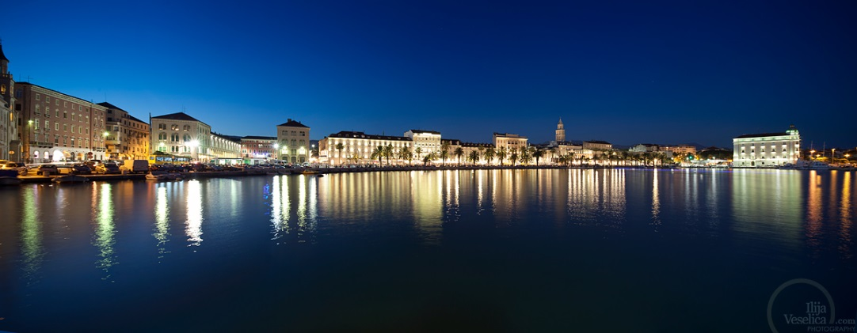
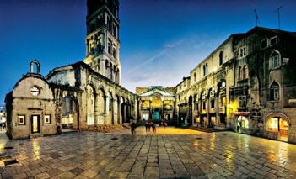
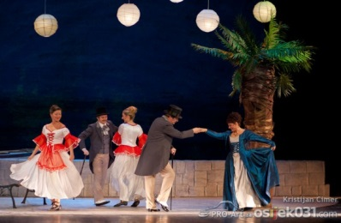
As a composer, Tijardović relied on folklore and a national musical expression, especially of his native region of Dalmatia. He composed eight operettas, the best known of which are Mala Floramye ("Little Floramye)
He reworked the old Split patriotic song "Marjane, Marjane", which soon became the city's anthem in the form he published it
Split – Tijardović’s birth place

Slide 9
Ivo Josipović
Ivo Josipović is the third president of the Republic of Croatia.
He graduated in 1983, majoring in compostition. He also holds a PhD in Law, and was a professor at Zagreb Law University as an emminent expert in the field.
Josipović composed some 50 chamber music pieces for various instruments, chamber orchestra and the symphony orchestra. Since 1991 Josipović has been a director of the Music Biennale Zagreb (MBZ), an international festival of contemporary classical music.
Amongst his many musical achievements and awards, his "Drmeš za Pendereckog" was also rewarded in 1987.
His piano perfomance of Ode to Joy on July 1st 2014 (when Croatia joined EU), was broadcasted worldwide.

Slide 10
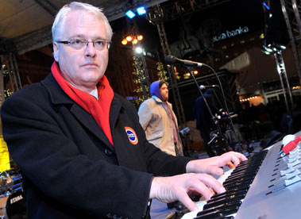
Our President spends his summers in his hometown Baška Voda, on Makarska Riviera

Slide 11
Thank you!

